Slide 1
BM3A - Introduction to Entrepreneurship
Professor Pi-Shen Seet
Edith Cowan University, Australia
1

Slide 2
Business Plan Resources
Resources for Business Plans
http://www.bplans.com/
WSJ Center for Entrepreneurs: http://www.miniplan.com/wsjminiplan/index.cfm?Affiliate=wsj
Deloitte: http://www.deloitte.com/dtt/cda/doc/content/WEBP_cv1(1).pdf
Businessweek: http://allbusiness.businessweek.com/3473091-1.html
US Small Business Administration: http://www.sba.gov/smallbusinessplanner/index.html
US Small Business Advancement Centre: http://www.sbaer.uca.edu/business_plan/businessPlan.pdf

Slide 3
Objectives
Describe (various) entrepreneurs, corporate entrepreneurship, and the characteristics of entrepreneurial firms.
Digital entrepreneurs and entrepreneurship
Discuss three main reasons people decide to become entrepreneurs.
Identify four main characteristics of successful entrepreneurs.
Describe three types of start-up firms.
Discuss the positive effects of entrepreneurship and entrepreneurial firms on economies and societies.
Explain the entrepreneurial process

Slide 4



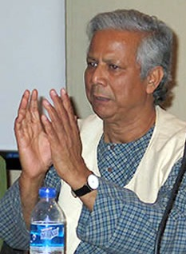
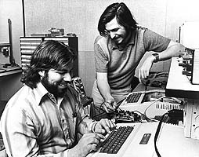


Ice-breaker
Who am I?
7
4
1
2
3
5 and 6
8

Slide 5
What is Entrepreneurship?
The term entrepreneur comes from the French word entreprendre meaning “between taker” or “go-between”.
In the middle of the 20th century the notion of entrepreneur as innovator was established.
Innovation, the act of introducing something new, is one of the most difficult tasks for the entrepreneur.
Entrepreneurship is the dynamic process of creating incremental wealth.

Slide 6
What is Entrepreneurship?
What is Entrepreneurship?
Academic Definition (Stevenson & Jarillo)
Entrepreneurship is the process by which individuals pursue opportunities without regard to resources they currently control.
Venture Capitalist (Fred Wilson)
Entrepreneurship is the art of turning an idea into a business.
Explanation of What Entrepreneurs Do
Entrepreneurs assemble and then integrate all the resources needed – the money, the people, the business model, the strategy – to transform an invention or an idea into a viable business.

Slide 7
Entrepreneurial personality
Is there a neat set of traits and behavioural characteristics that distinguish entrepreneurs from non-entrepreneurs?
Are entrepreneurs born or made?
Can entrepreneurship be taught?

Slide 8
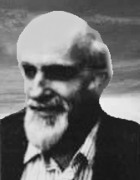
Entrepreneurial personality
Characteristics of entrepreneurs (D. McClelland “The Achieving Society”)
High need for achievement
Desire for responsibility
Preference for moderate risk
Confidence in personal success
Desire for immediate feedback
High level of energy
Future orientation
Skill at organising
Value of achievement over money

Slide 9
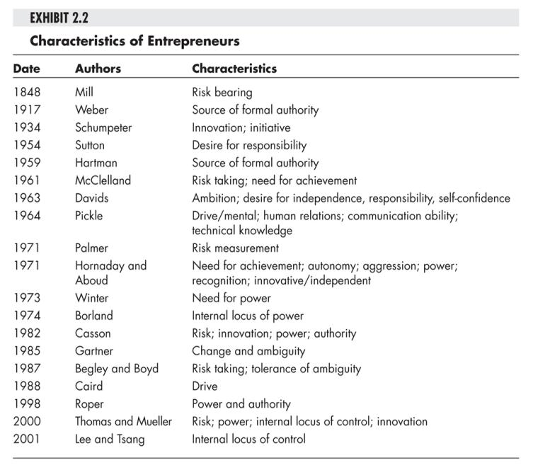

Slide 10
Behavioural approach to entrepreneurship (Gartner, 1989; Vesper, 1982)
Successful entrepreneurs have a wide range of personality types
no psychological model of entrepreneurship has been supported.
Acquired skills are more important that specific inherent traits
“Who is entrepreneur? is a wrong question” (Gartner)
“What entrepreneur does?” is much more important to consider.
Entrepreneurship is the process of creation of organisations.

Slide 11
Entrepreneurial Behaviour
The entrepreneurial act is the act of creating a business by:
perceiving an opportunity
assessing the opportunity
risking resources to exploit the opportunity
managing the process of building a venture from and idea
managing creative value
having a passion to build innovative businesses from the idea stage.
continuing to act entrepreneurially, making strategic decisions that engage the business in risk-oriented activity, growth, and consequent high performance.

Slide 12
Types of Entrepreneurship
Entrepreneurship in general
Intrapreneurship
Digital entrepreneurship
Social entrepreneurship
Women entrepreneurship

Slide 13
Corporate Entrepreneurship
Corporate Entrepreneurship (Intrapreneurship)
Is the conceptualization of entrepreneurship at the firm level.
All firms fall along a conceptual continuum that ranges from highly conservative to highly entrepreneurial.
The position of a firm on this continuum is referred to as its entrepreneurial intensity.

Slide 14
Corporate Entrepreneurship
Entrepreneurial Firms
Conservative Firms
Proactive
Innovative
Risk taking
Take a more “wait and see”
posture
Less innovative
Risk averse

Slide 15
Beyond Start Ups – The Intrapreneur
An Intrapreneur is someone who has an entrepreneurial streak in his or her DNA, but chooses to align his or her talents with a large organization in place of creating his or her own.
Intrapreneurs are critical, because in a world filled with fast-moving change, a large organization that becomes complacent and loses sight of the benefits of having an entrepreneurial streak built into their massive global systems can find themselves disrupted in short order.

Slide 16
Why Become an Entrepreneur?
The three primary reasons that people become entrepreneurs and start their own firms
Desire to be their own boss
Desire to pursue their
own ideas
Financial rewards

Slide 17
Who is the Entrepreneur?

Slide 18
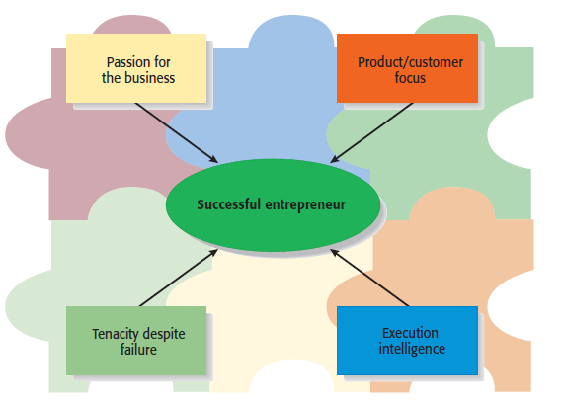
Characteristics of Successful Entrepreneurs
Four Primary Characteristics

Slide 19
Types of Start-Up Firms

Slide 20
Economic Impact of Entrepreneurial Firms
Innovation
Is the process of creating something new, which is central to the entrepreneurial process.
Small innovative firms are 16 times more productive than larger innovative firms in terms of patents per employee.
Job Creation
Small businesses create a substantial number of net new jobs in the United States.
Firms with 500 or fewer employees create 65% of new jobs on an annual basis.

Slide 21
Entrepreneurial Firms’ Impact on Society and Larger Firms
Impact on Society
The innovations of entrepreneurial firms have a dramatic impact on society.
Think of all the new products and services that make our lives easier, enhance our productivity at work, improve our health, and entertain us in new ways.
Impact on Larger Firms
Many entrepreneurial firms have built their entire business models around producing products and services that help larger firms become more efficient and effective.

Slide 22
The Entrepreneurial Process
Steps in the Entrepreneurial Process
The Entrepreneurial Process Consists of Four Steps
Step 1: Deciding to become an entrepreneur.
Step 2: Developing successful business ideas.
Step 3: Moving from an idea to an entrepreneurial firm.
Step 4: Managing and growing the entrepreneurial firm.

Slide 23
Steps in the Entrepreneurial Process
Step 1
Step 2
Developing Successful Business Ideas

Slide 24
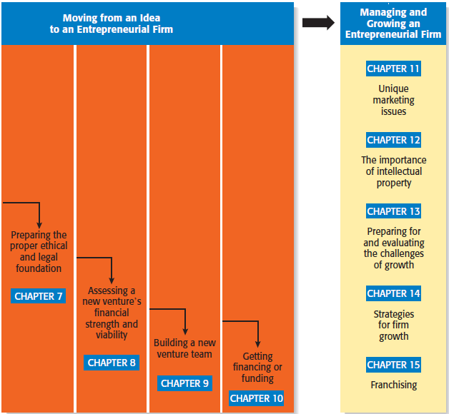
Steps in the Entrepreneurial Process
Step 3
Step 4

Slide 25
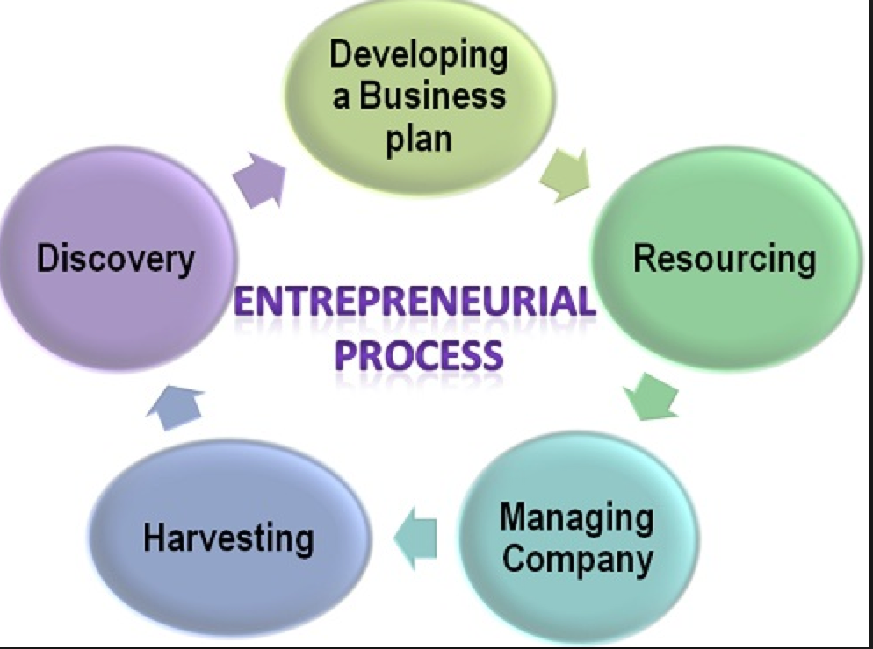
Entrepreneurial Process

Slide 26
Prepare for next class - Activity: Personal Entrepreneurial Characteristics (PEC) exercise
Please compete questionnaires and compute your scores (see Moodle).
Compare your scores with other team members (next week).
Is this a useful tool? Why or why not?
If you are interested:
BBC’s Mind of a Millionaire test: http://www.bbc.co.uk/science/humanbody/tv/millionaire/

Slide 27
What else before the next class
Form groups – email me the group leader and members names
Go through the syllabus and Moodle site and highlight any questions in the discussion board
Prepare for next class - Activity: Personal Entrepreneurial Characteristics (PEC) exercise
Please compete questionnaires and compute your scores (see Moodle).
Compare your scores with other team members (next week).
Is this a useful tool? Why or why not?
If you are interested:
BBC’s Mind of a Millionaire test: http://www.bbc.co.uk/science/humanbody/tv/millionaire/
27

